Slide 1
SUPERSTORE ANALYSIS
By - Group (101) Mentorship

Slide 2
EXECUTIVE SUMMARY
Objective: Extract insights from the Superstore Sales Dataset to improve operational efficiency and decision-making in a retail environment.
Revenue Concentration: The majority of total revenue (64.3%) is generated by a relatively small number of high-value "Outlier" transactions.
Operational Efficiency: Shipping performance varies significantly by class (First Class: 1–3 days; Standard Class: 4–6 days), with Central and East regions experiencing slightly longer durations.
Demand Planning: Order volume follows clear seasonal patterns, peaking in the later months of the year (September–December).
Significance: Data-driven insights identify specific areas (logistics, sales strategy, and demand planning) where the superstore can enhance performance.

Slide 3
BUSINESS OBJECTIVE
Goal: Gain deeper insights from the Superstore Sales Dataset to streamline the activities of the superstore and support better management of sales operations.
Key Questions Addressed by Analysis:
How do different shipping classes perform across various regions (Ship Modes)?
What is the revenue contribution by order value category?
What are the order volume trends by month and day of the week?
How do annual sales by product category compare across different years?

Slide 4
KEY FINDINGS
AND VISUALIZATIONS

Slide 5
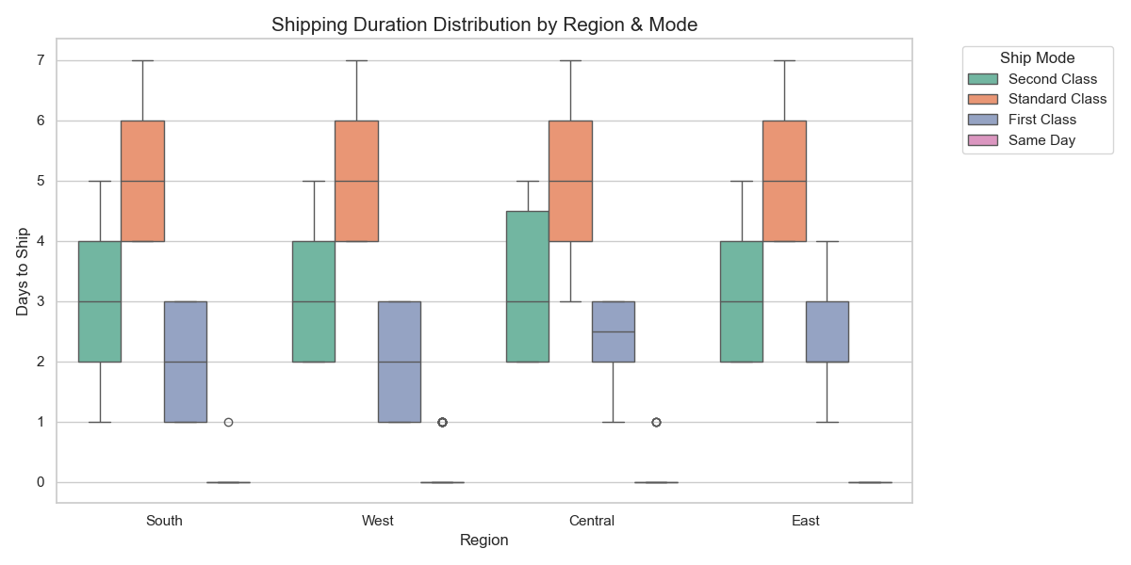
SHIPPING PERFORMANCE
Shipping Duration by Region and Ship Mode Delivery Speed by Class:
First Class shipments are the fastest, typically delivered within 1 to 3 days.
Second Class takes 2 to 4 days.
Standard Class shipments generally require 4 to 6 days.
Regional Inefficiency: Deliveries to the Central and East regions showed slightly longer durations, even for faster shipping classes, suggesting potential logistical factors affecting delivery speed in these areas.

Slide 6
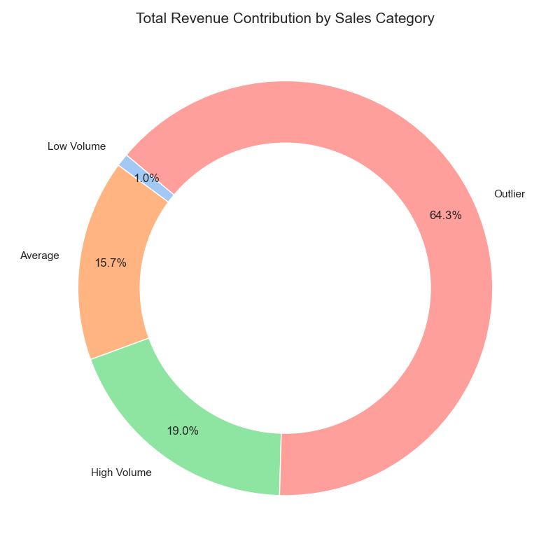
REVENUE DISTRIBUTION
Revenue Contribution by Order Value Category
High Dependency: The business relies heavily on large-value transactions.
Outlier Contribution: Orders categorized as "Outliers" (very large orders) contributed the majority of total revenue at 64.3%.
Mid-Value Segment: High Volume orders accounted for 19% of total revenue, and Average orders accounted for 15.7%.
Low Impact: Low Volume orders contribute only 1% to overall revenue.

Slide 7
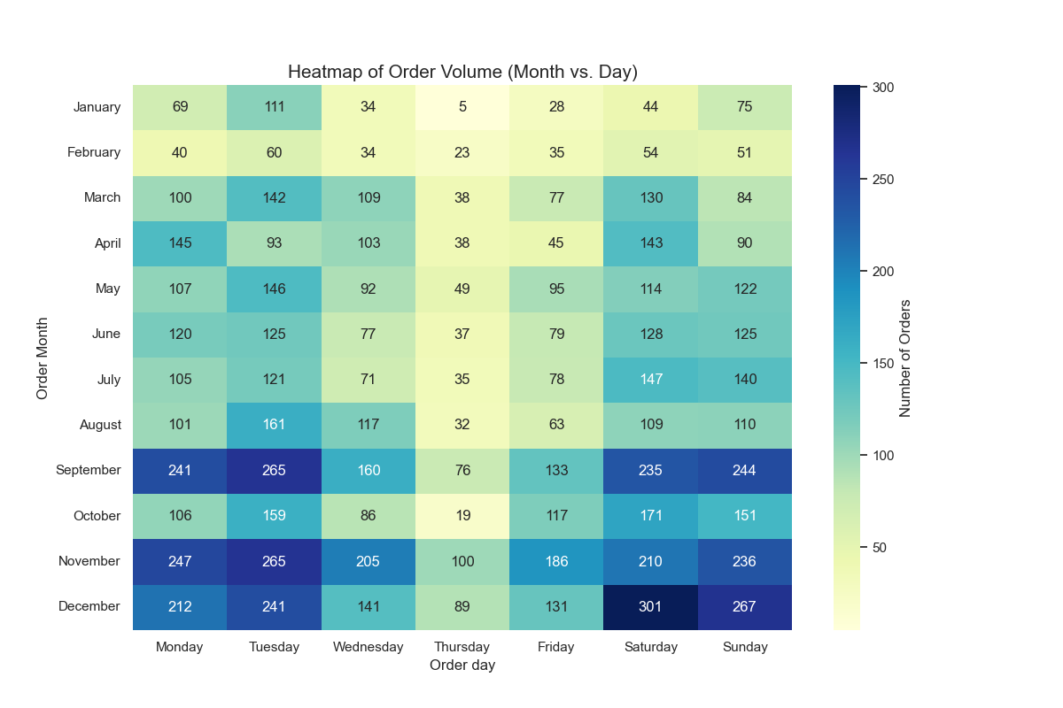
ORDER VOLUME TRENDS
Seasonal and Weekly Order Patterns
Peak Season: The busiest months for orders are December, November, September, and October, indicating increased seasonal demand toward the end of the year.
Busiest Days: Order volumes are highest on Saturday, Sunday, Tuesday, and Monday.
Slow Periods: Thursday and Friday experience relatively lower order volumes. The lowest activity was observed on Thursdays in January.

Slide 8
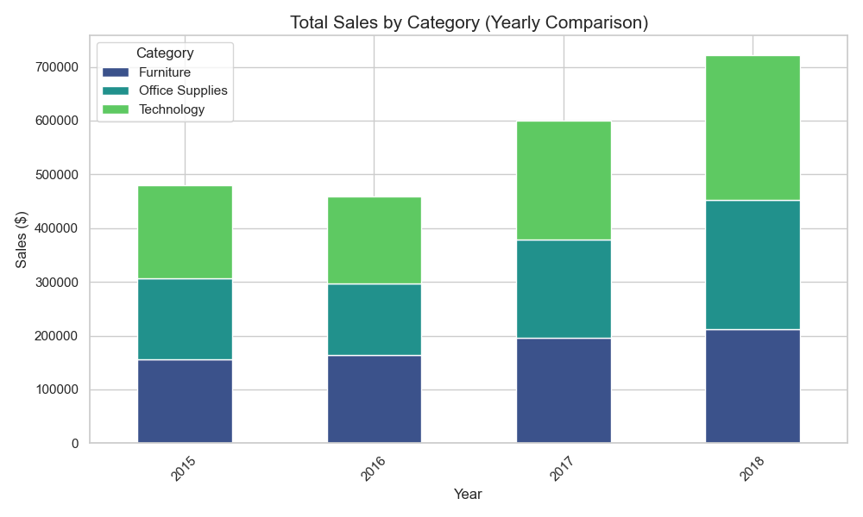
YEARLY SALES COMPARISON
Sales Performance by Product Category (2015–2018)
Overall Trend: Total sales generally increased over the years in the dataset.
2016 Decline: Total sales declined in 2016 compared to the previous year, the only decline observed.
Key Drivers of Decline: This reduction was largely driven by decreased sales within the Office Supplies and Technology categories, highlighting their dominant role in overall revenue trends.

Slide 9
RECOMMENDATIONS
Improve Shipping Logistics: Review and optimize logistics operations (routes, warehouse locations, shipping partners) in the Central and East regions to reduce delivery durations.
Strengthen High-Value Customer Relationships: Implement strategies like loyalty programs or personalized offers to retain high-value customers who generate the majority of revenue.
Optimize Inventory Management: Ensure adequate inventory levels from September through December to prevent stock shortages during peak demand periods.
Stimulate Low Activity Periods: Launch targeted promotions or marketing campaigns during low order activity times (e.g., early-year months and weekdays) to boost demand.
Monitor Category Performance: Continuously monitor category-level sales, particularly for Office Supplies and Technology, and rapidly respond to declining trends with pricing or product diversification.

Slide 10
LIMITATIONS
Data Scope: The analysis is based exclusively on the Superstore Sales Dataset, which may limit the generalizability of the findings to other retail environments or broader market conditions.
Time Period: Sales performance comparisons are confined to the years covered in the dataset (2015–2018).
Focus on Revenue/Shipping: The study focuses on sales revenue and shipping duration but does not integrate other critical performance metrics like profitability (e.g., costs, margins) or customer satisfaction feedback, which would provide a more complete view of operational efficiency.

